Slide 1
Inflation's Ripple Effect: Unraveling the Socioeconomic Threads of Income Inequality
A Presentation by Adriel Willis
November 17, 2023

Slide 2
Research Question
How does inflation impact income inequality, and what are the social consequences of a widening wealth gap in diverse economic environment?

Slide 3
Thesis Statement
My paper asserts that inflation, when left unaddressed, exacerbates income inequality, leading to social disparities and diminished opportunities for vulnerable populations.

Slide 4
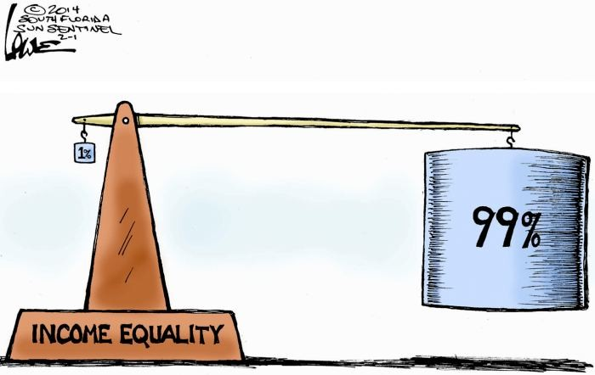
Introduction
Brief overview of income inequality as a persistent concern in the United States.
The role of fiscal and monetary policies

Slide 5

“Explain The Issue Like I am Five?”
The best way to explain such an intricate issue like this is to explain it the way I would to a five year old

Slide 6
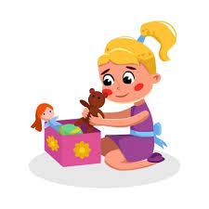
ELI5 Continued(Income Inequality)
Imagine you and your friends also get toys every week as a reward
But, here's the thing - some friends get more toys, and some friends get fewer toys.
That's a bit like income inequality! Some families have more money, and some have less. This can make it seem like some friends have more toys and candy to enjoy than others.

Slide 7
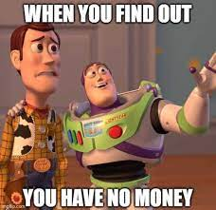
ELI5 Continued (Inflation)
Now, let's say the toys you get every week start costing more
That means you need more money to buy the same amount of toys
Inflation is when things get more expensive over time.
So, if the toys get pricier, it might be harder for some friends (especially those with fewer toys) to keep up and get what they need.

Slide 8

ELI5 Continued (My Specific Paper Topic)
Imagine you have a friend named Michael Wazowski
He has fewer toys and games than some other friends.
If the toys become more expensive (inflation), it might be harder for his family to buy them.
This could make it even trickier for M.Wazowski to get as many toys as he used to
The difference between what he has and what others have might become even bigger (income inequality).

Slide 9
Background and Research on Inflation and Income Inequality:(Comprehensive Takeaways)
In the initial stages, inflation has a reducing effect on income inequality
A comprehensive study across the 50 U.S. states from 1976 to 2007 reveals a non-linear relationship between inflation and income inequality, emphasizing the challenges faced by policymakers despite efforts by the Federal Reserve.
The trajectory of inflation disparities is not static but evolves over time.
Inflation affects households differently based on their expenditure priorities
Importance of balancing short-term measures with long-term considerations for maintaining economic stability and reducing inequality

Slide 10
ELI5 (Comprehensive Takeaways)
In the initial stages, inflation has a reducing effect on income inequality
Imagine you have ten toys, and your friend has only two. Now, let's say the prices of all toys go up. Since you both have more toys, the difference between you and your friend doesn't feel as big. It's like everyone's toy collection is growing together, and the gap between you and your friend gets smaller at first.
The trajectory of inflation disparities is not static but evolves over time:
Picture a rollercoaster that goes up and down. Inflation, like the rollercoaster, doesn't stay the same all the time. Sometimes it goes up fast, and other times it slows down. So, the way it affects how much things cost and who it helps or hurts can change as time goes by, just like how a rollercoaster changes as it moves.
Inflation affects households differently based on their expenditure priorities:
Think about a family that spends more money on food than on toys. If the prices of food go up a lot, it can make it harder for the family to have enough money for other things. Inflation doesn't affect everyone the same way because some people spend more on certain things, like food or toys, and when the prices change, it can make a big difference for them.

Slide 11
ELI5 (Comprehensive Takeaways Pt.2)
Importance of balancing short-term measures with long-term considerations for maintaining economic stability and reducing inequality:
Imagine you are building a tower with blocks. If you only focus on making the tower really tall right now, it might fall over because it's not stable. Balancing means making sure the tower is not only tall but also strong and won't fall easily. The people in charge of the country need to think about what helps everyone now and what will keep things good for a long time, like building a tower that lasts.
A comprehensive study across the 50 U.S. states from 1976 to 2007 reveals a non-linear relationship between inflation and income inequality, emphasizing the challenges faced by policymakers despite efforts by the Federal Reserve:
Think of the U.S. as a giant Rubik's Cube with 50 different sections, each representing a state. Now, when you try to solve the Rubik's Cube, turning one side doesn't always fix everything. Sometimes, it makes other parts more mixed up! Similarly, when policymakers try to fix how much money people have (that's the income) by dealing with inflation (which is like turning the cube), it doesn't always make things fair for everyone.

Slide 12

Policy and Strategy Analysis
Key policy considerations related to inflation and income inequality?
So what do we know…..
Monetary Policy
Interest Rates: Central banks use interest rates to manage inflation.
Impact on Income: The effectiveness of this approach varies for different income groups.
Fiscal Policy
Government Spending: Policies involving taxes and public sector employment directly influence income distribution.
Redistributive Effects: Crafting fiscal policies considering redistributive effects can target specific income groups.
Inflation's Impact on Real Wages
Nominal vs. Real Wages: During inflation, nominal wages may not keep up with rising prices, affecting real purchasing power.
Disproportionate Effects: Lower-income individuals, heavily reliant on wage income, are more vulnerable.

Slide 13

Policy and Strategy Analysis
(Pt.2)
So in an ideal world how would one address this issue…..?
Monetary Policy Adjustments: Influence on various income sources, especially for lower-income individuals.
Fiscal Policy Measures: Tax policies, public sector employment, and government spending as direct levers for income distribution.
Social Safety Nets: Strengthening programs like welfare and unemployment benefits as a buffer during inflationary periods.

Slide 14

Examples From Other Countries:(Inspiration For Policy)
Look no further than Brazil for an example on how to beat inflation!
Brazil successfully combated hyperinflation through a clever economic strategy involving the introduction of a transitional currency called the Unidade Real de Valor (URV). This "fake" currency acted as a stabilizing force by providing a stable reference point for prices during a period of rampant inflation. Prices were displayed in URV, allowing people to become accustomed to stable prices, mitigating the psychological impact of inflation. After a predetermined transition period, Brazil smoothly transitioned to a new currency, the United Dollar (UD). This strategic approach helped create an environment of stability, predictability, and equality in the face of hyperinflation, showcasing the effectiveness of innovative economic interventions in times of economic turmoil.

Slide 15


My Specific Policy
Comprehensive Economic Policy Measures:
Government Spending Reform:
Disciplined and targeted cuts for efficient resource allocation.
Monetary Policy Adjustments:
Strategic use of tools, including interest rate adjustments.
Innovative Psychological Intervention - URV-inspired Transition:
Introduction of Stability Units (SU):
Symbolic currency for public transactions.
Normalization of Pricing in SU:
Stable prices during a predetermined transition period.
Seamless Transition to a New Currency - "United Dollar (UD)":
Execution on a designated day for a clear understanding of the new currency's value.

Slide 16
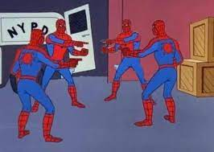
Conclusion:Impact of Inflation on Income Inequality
Wealth Gap Widening: Inflation widens the wealth gap, hitting vulnerable groups harder.
Differential Impacts: Different racial and income groups experience diverse effects.
Need for Safety Nets: Robust social safety nets are crucial for inclusive policies.
Global Awareness: The issue demands international cooperation for global stability.
Long-Term Focus: Understanding evolving inflation dynamics guides effective, adaptive policies.
Call for Collective Action: Addressing inflation-induced income inequality is a shared responsibility for a fairer economic landscape.

